Slide 1
Excel Essentials: Data Entry, Tables & Charts
David Moloney
Jasmine Ryan

Slide 2
👋 Hello & Welcome
⏳ This session will begin shortly.
While you wait, please download the slides for today’s session from the LevUL up website.
In association with:

Slide 3
Recording
This session will now be recorded. Any further information that you provide during a session is optional and in doing so you give us consent to process this information.
These recordings will be stored by the University of Limerick for one year and may be published on our website during that time.
By taking part in a session you give us your consent to process any information you provide during it.

Slide 4
Who we are
Jasmine Ryan
UL Student Associate Intern, Enhancing Digital Teaching and Learning (EDTL) project, Centre for Transformative Learning​
David Moloney
UL Project Lead, Enhancing Digital Teaching and Learning (EDTL) project, Centre for Transformative Learning​
COMPANY CULTURE BOOK

Slide 5
Introduction
Editing Text & Cells
Editing the Worksheet
Printing & Sharing
Charts, Graphs & Pivot Tables
Formulas
Recap/Summary
Overview

Slide 6
How we intend for you to engage with this workshop...
•We would like you to be able to follow along with us and make edits to your downloaded sample file during this workshop.
•If you only have one screen, you can set up the two windows side by side in a split screen set-up.
•Please keep your camera & microphone off during the workshop
•Ask questions in the chat

Slide 7
Introduction
Why learn Excel?
A high in demand skill
Great for personal budget/life management

Slide 8
Editing text and cells
Format cells
Adjust row and column height/width
Merge & centre
Create angled text for headings

Slide 9
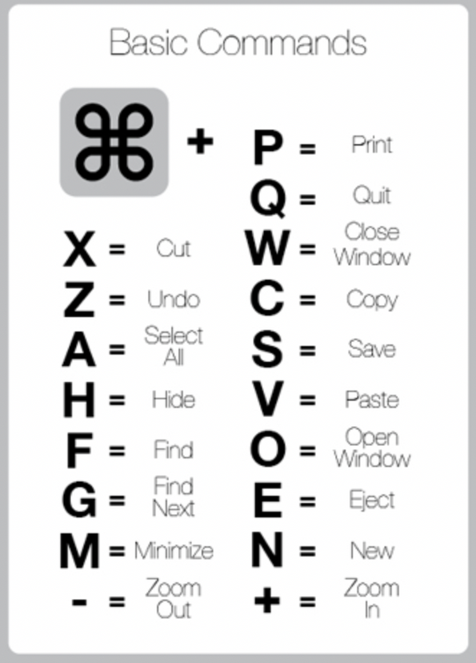
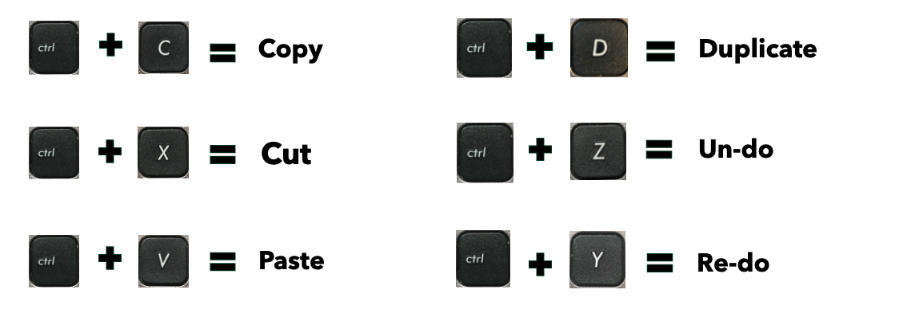
Windows
Mac OS

Slide 10
Editing the Worksheet
5. Border Options
6. Freezing panes for scrolling
7. Page View options

Slide 11
Printing & Sharing
8. Print Options
9. Freezing panes for scrolling

Slide 12
Charts, Graphs & Tables
112. Use the ADD, SUBTRACT, MULTIPLY and DIVIDE formulas
13. Use the SUM formula
14. Use the AVERAGE formula
15. Use the IF formula
16. Use the VLOOKUP formula

Slide 13
Reflection & Questions

Slide 14
Support & Resources
Free resource detailing how to use features in Excel.
https://edu.gcfglobal.org/en/excel/
• YouTube videos
• Skillshare
• Udemy
• LinkedIn Learning courses

Slide 16
Thank you!

